Slide 1

Database Management System
Project

Slide 2


Airline Management System
About us
Aditya Shah : 202003045

Slide 3
01
List of functional requirements ordered based on the importance level
CONTENT ORDER
02
ER Model
03
Relational Model
04
SQL DDL statements
05
Functional Dependencies

Slide 4
06
Data Insertion
CONTENT ORDER
07
Query
08
Views
09
Functions/Procedures/ Cursors
10
Java Code with JDBC API

Slide 5
Scope of Database
Entity
Project Description
Scope of Database, Entity, Relationship :
We are making a database for a user so that he/she can book tickets for any destination from any airport. They can compare prices of different airlines and book their flight for suitable dates. The database also shows arrival & departure time with some additional information about their arrival and departure airport. While booking tickets user can choose the flights with or without junctions and also user can see flying time of their journey.
• Airplane • Seat (Weak Entity)
• Airport • Traveller (Weak Entity)
• Flight Trip • Fare (Weak Entity)
• Travel Agent • Airline Company (Weak Entity)
• Junction • User

Slide 6
Relationship
• Airport – Airplane, Relation –access, Relation Type- many to many relation.
• Airport – Junction, Relation – arrival, Relation Type – one to many relation.
• Airport – Junction, Relation – departure, Relation Type – one to many relation.
• Airplane – Seats, Relation- has ,Relation Type – one to many relation.
• Seats- Traveller, Relation- reserved , Relation Type – one to one relation.
• Traveller – Flight Trip , Relation- Travels ,Relation Type – many to one relation.
• Flight Trip – Fare, Relation- costs ,Relation Type – one to one relation.
• User – Flight Trip, Relation- books ,Relation Type – one to many relation.
• Travel Agent –Flight trip, Relation-books, Relation Type – one to many relation.
• Flight trip – Junction, Relation-has, Relation Type – many to many relation.
• Airplane – Junction, Relation- joints, Relation Type – one to many relation.
• Fare –Airplane Company, Relation –of ,Relation Type – one to many relation.

Slide 7
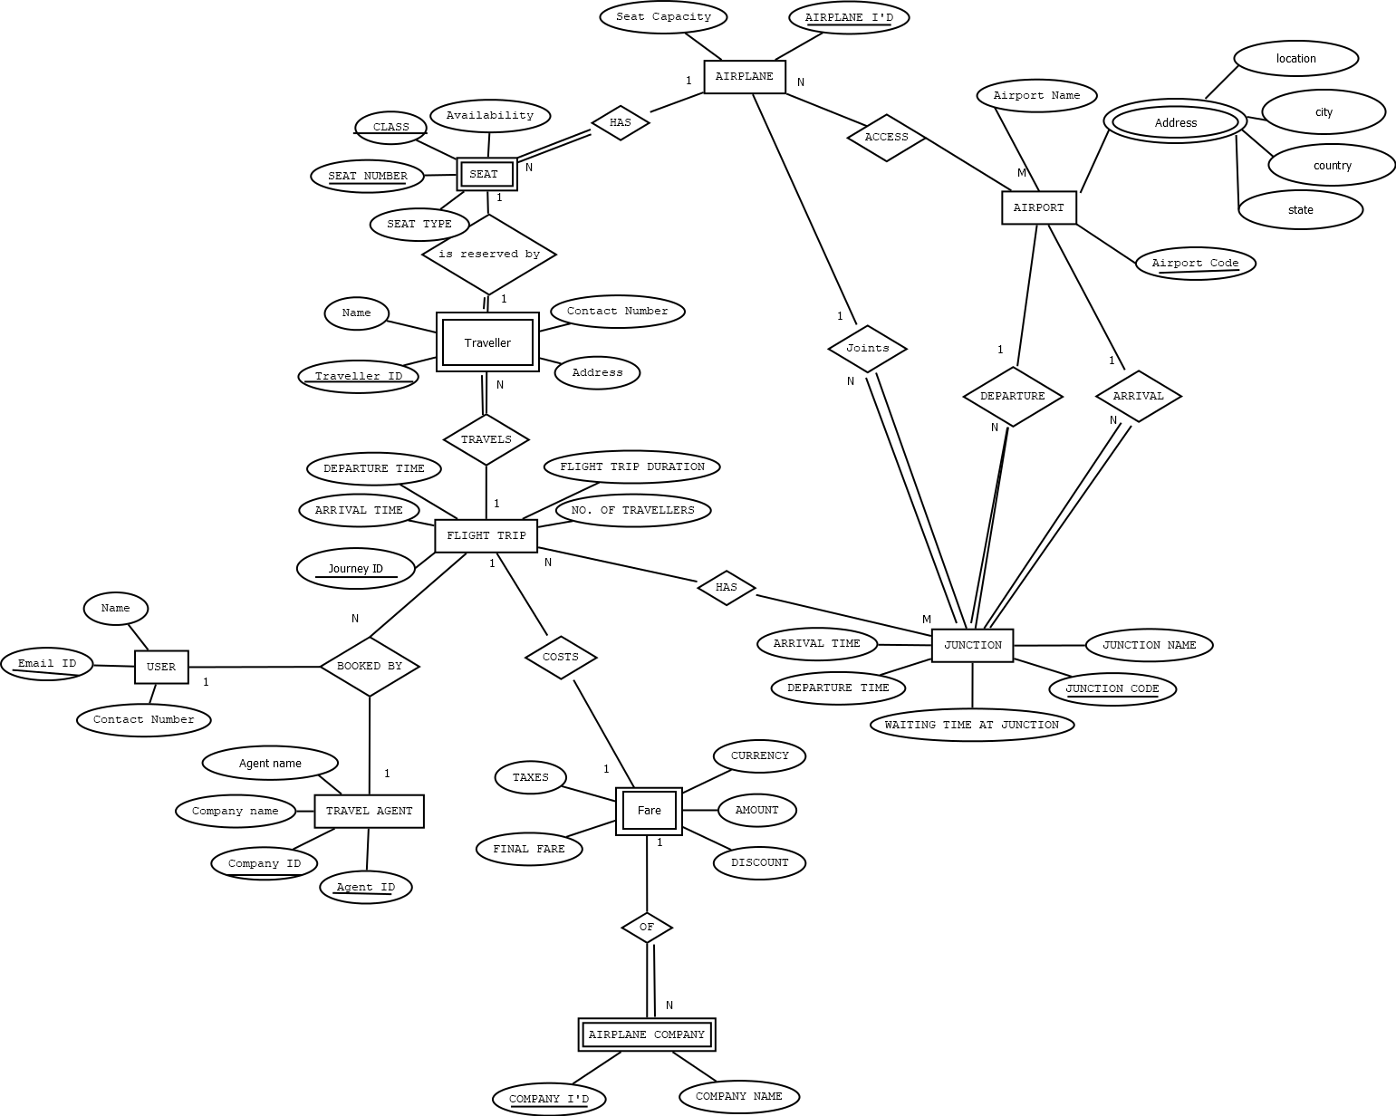
ER Diagram

Slide 8
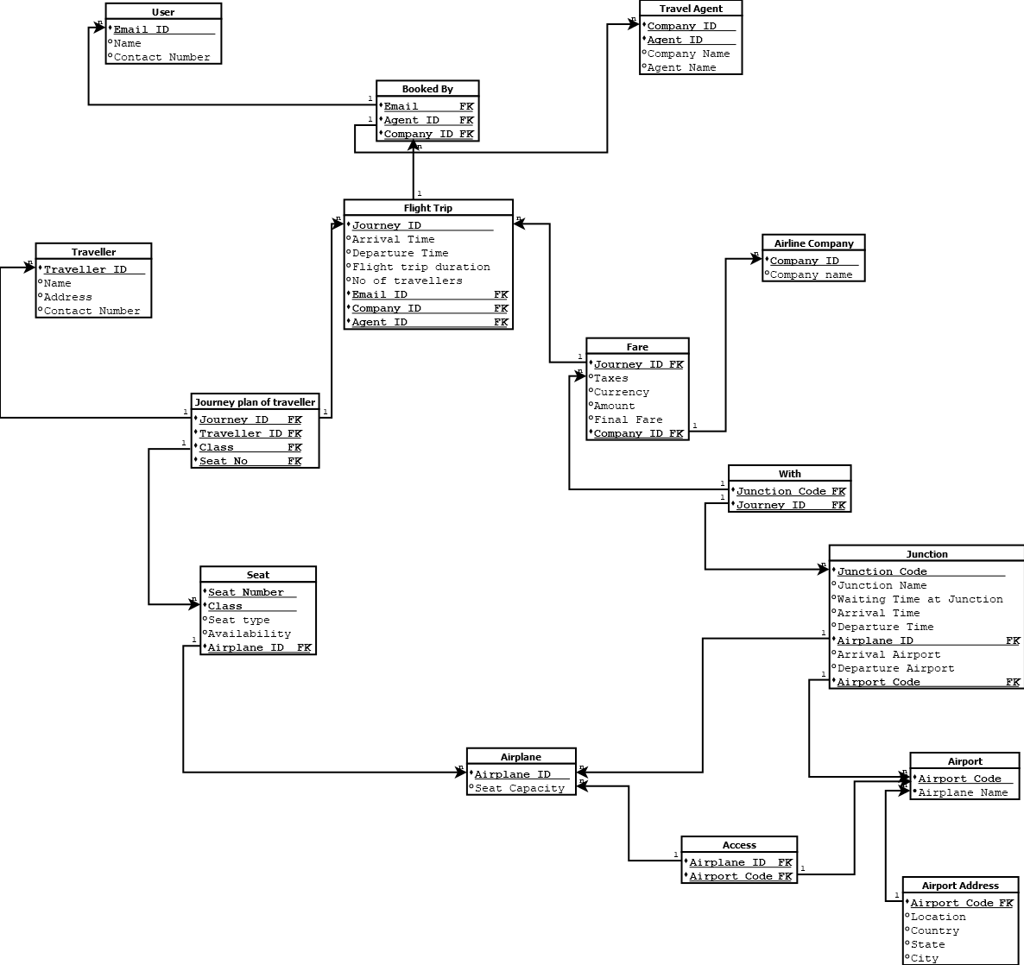
Relational Model

Slide 9
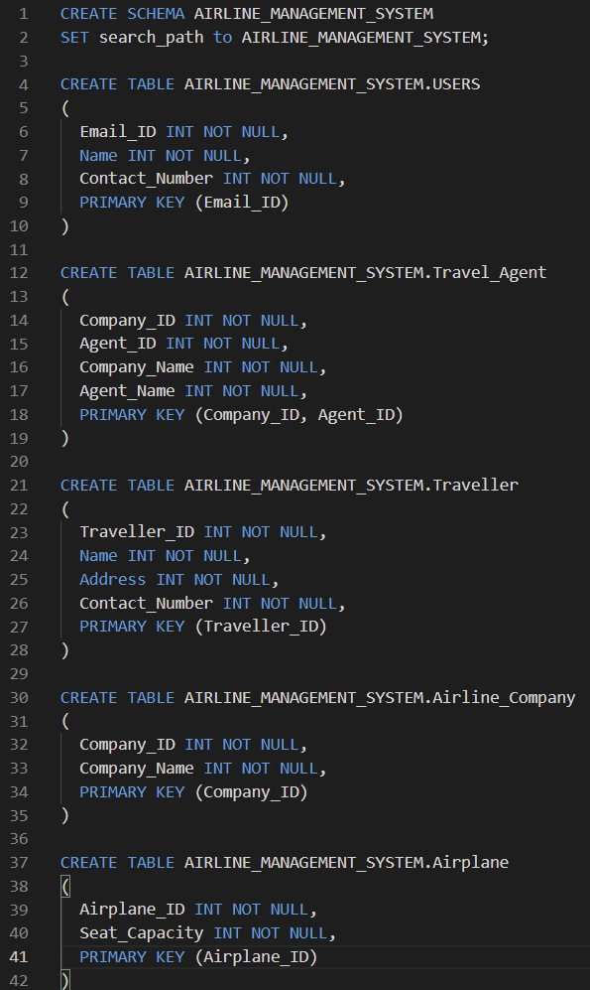
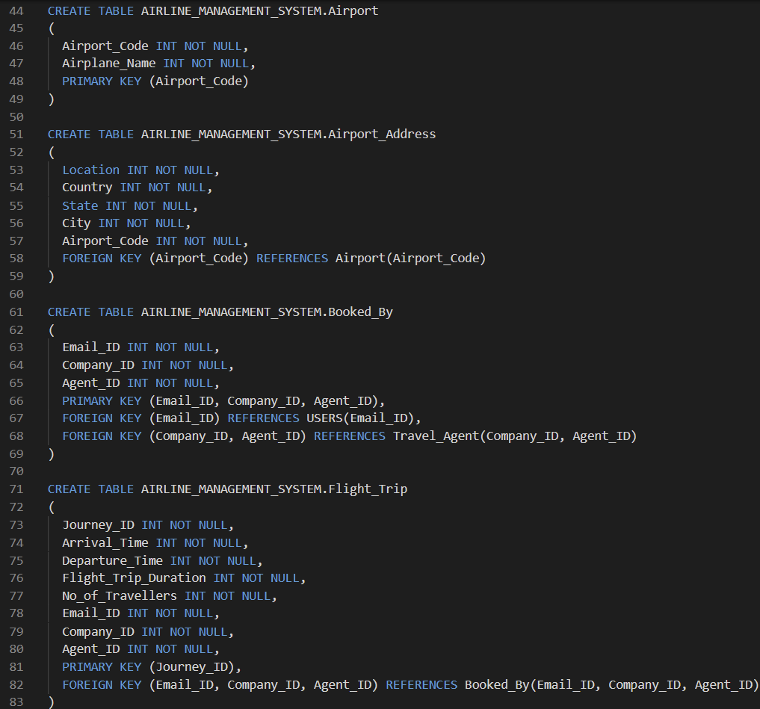
SQL DDL

Slide 10
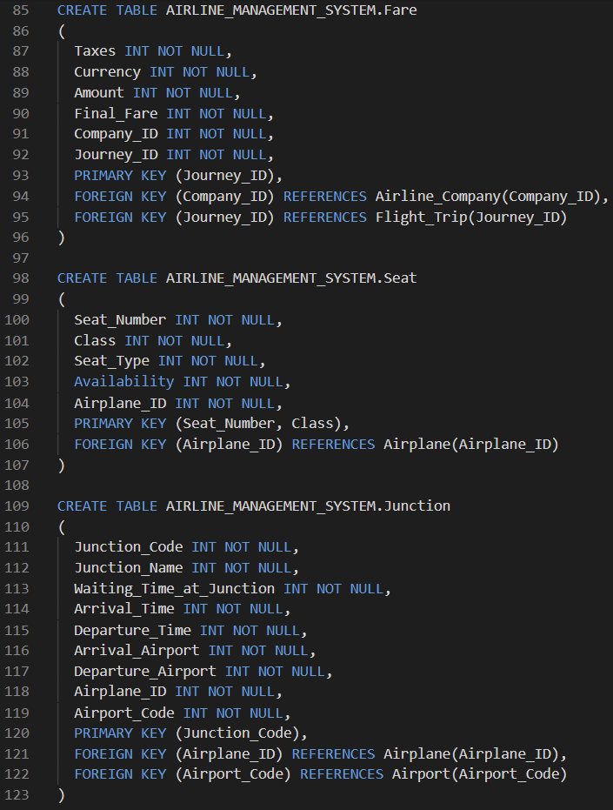
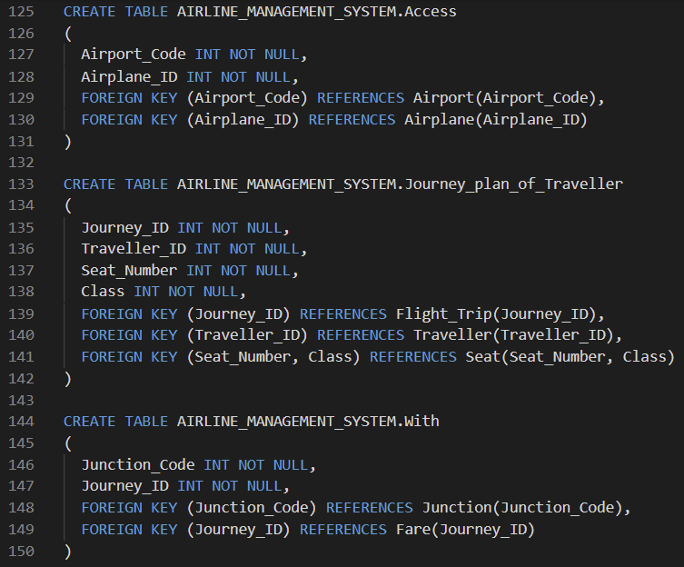
SQL DDL

Slide 11
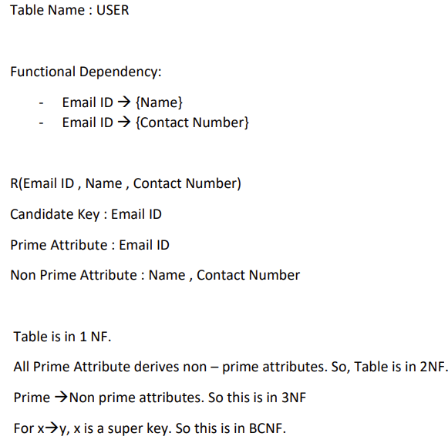
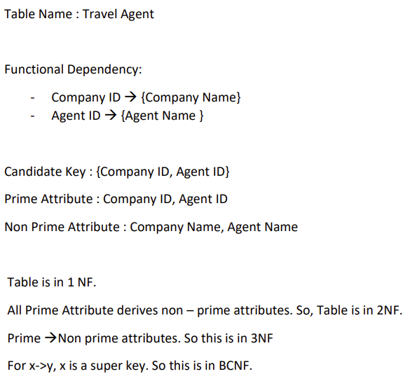
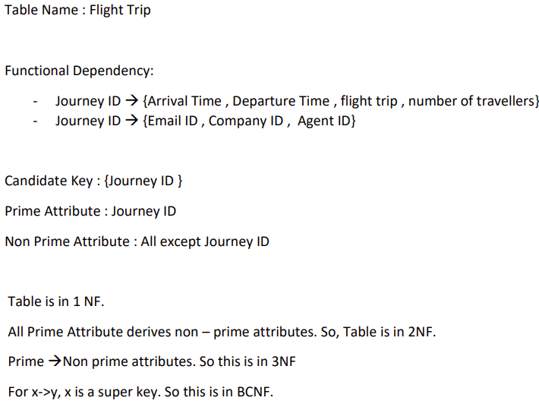
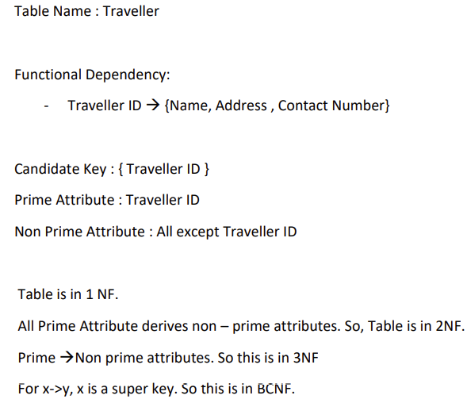
Functional Dependencies

Slide 12
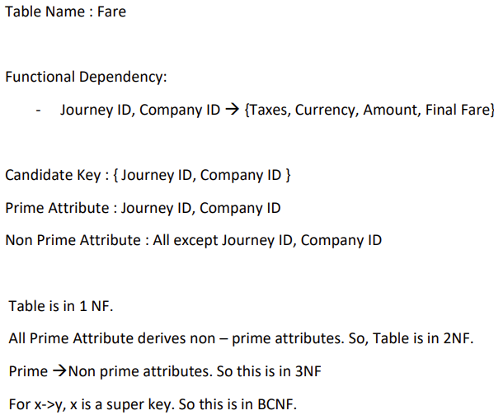
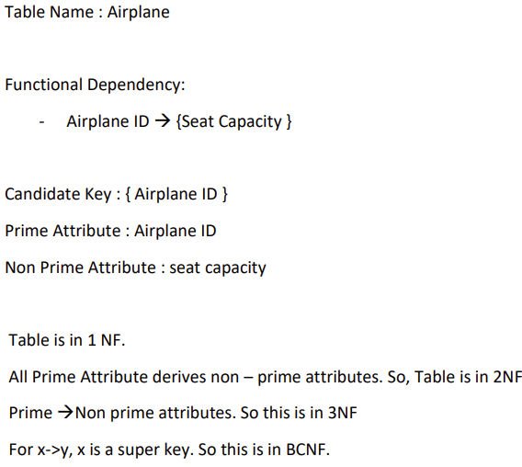
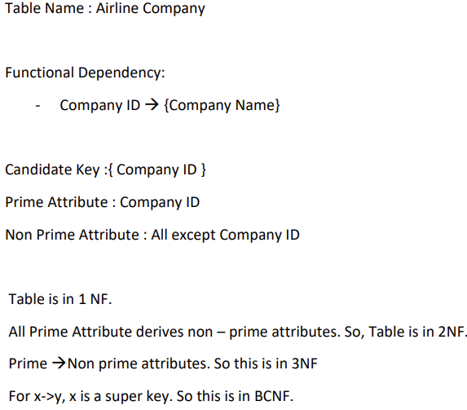
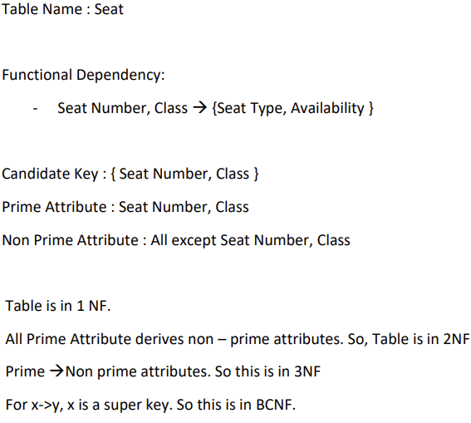
Functional Dependencies

Slide 13
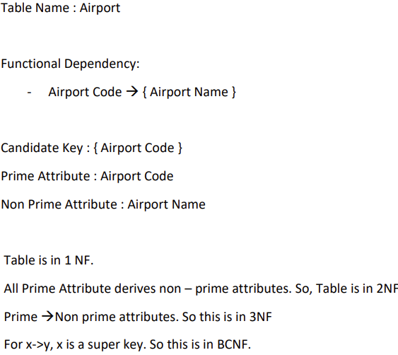
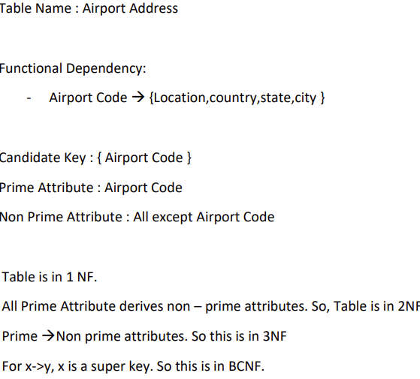
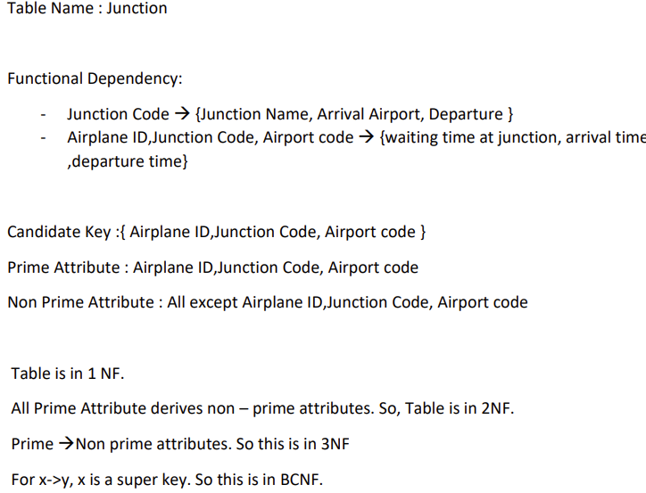
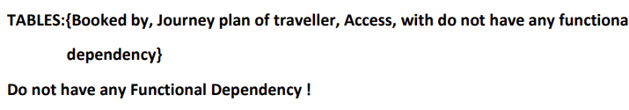
Functional Dependencies
Note :

Slide 14

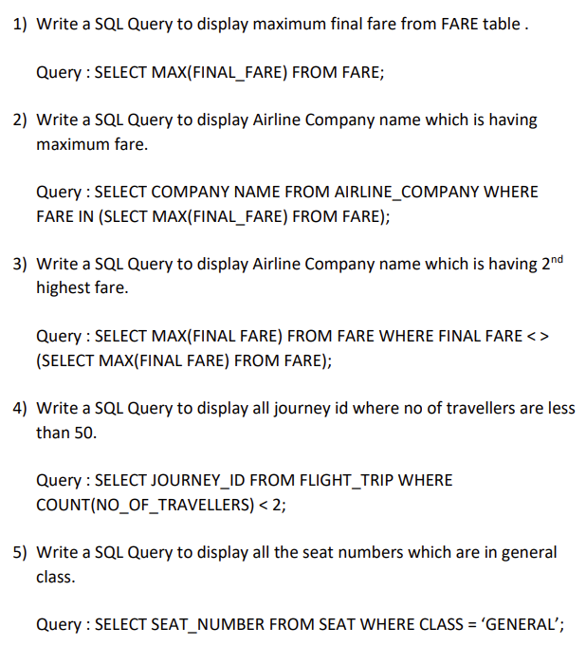
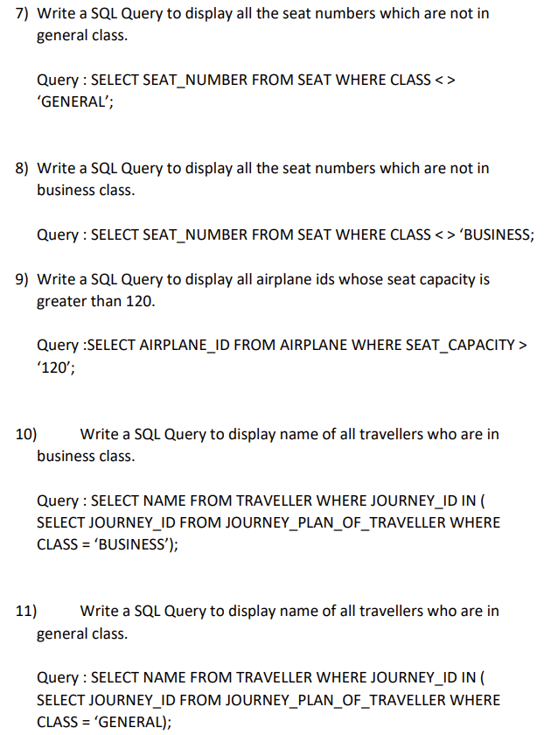
Query
—SOMEONE FAMOUS

Slide 15
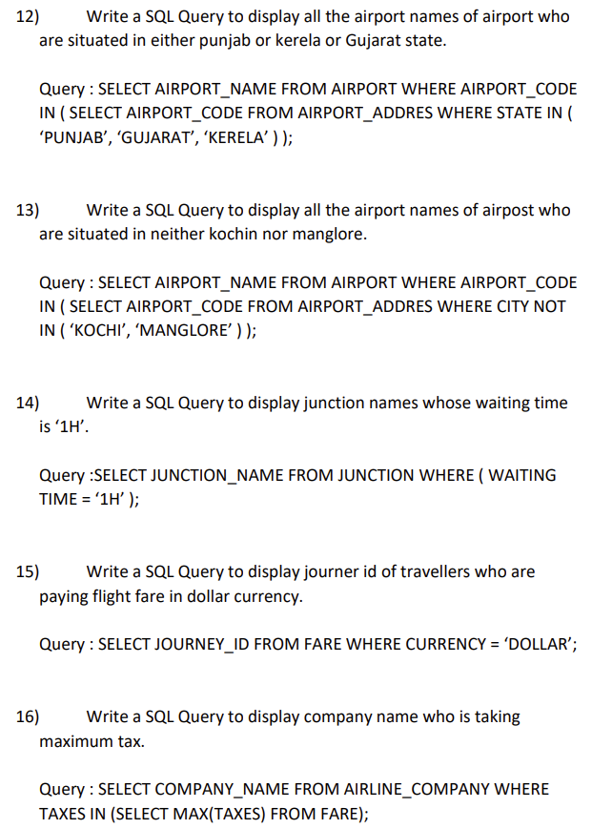
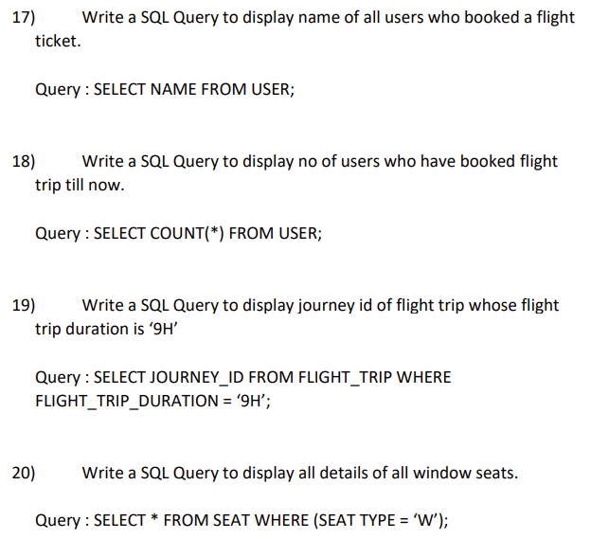
Query
—SOMEONE FAMOUS

Slide 16
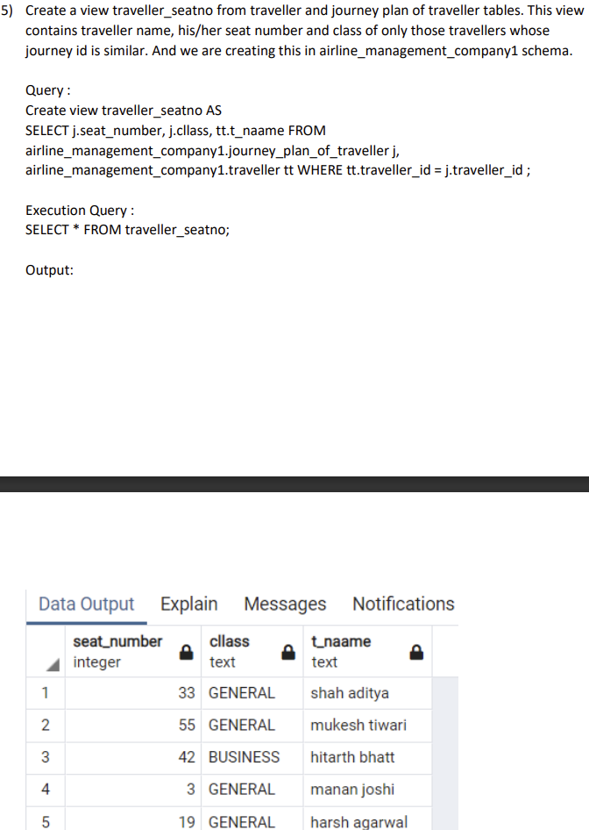
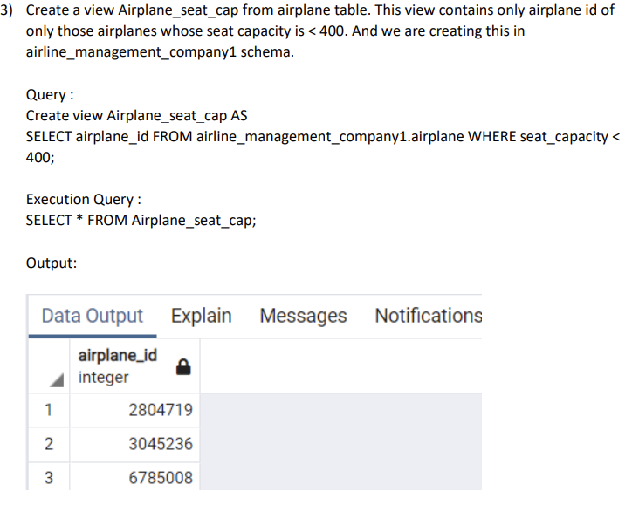
Views

Slide 17
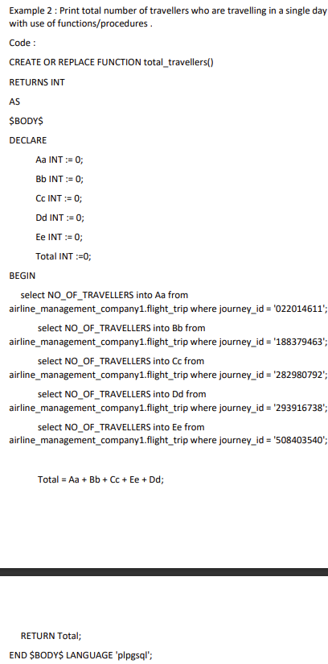
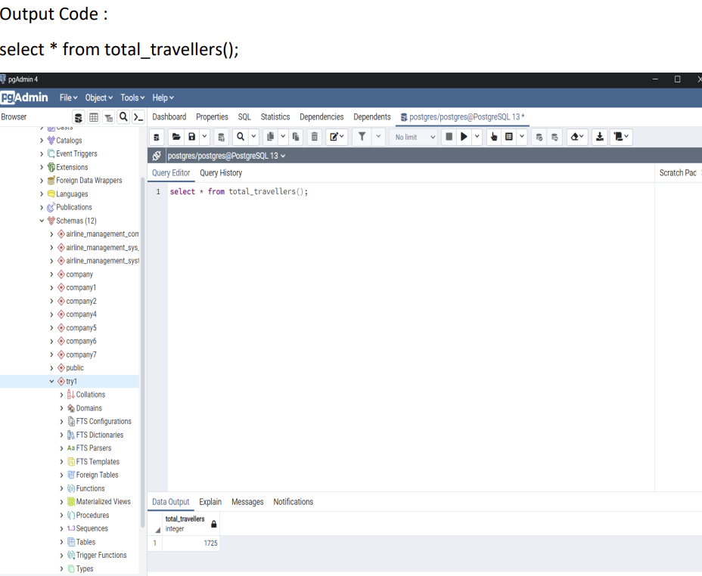
Function/ Procedure

Slide 18
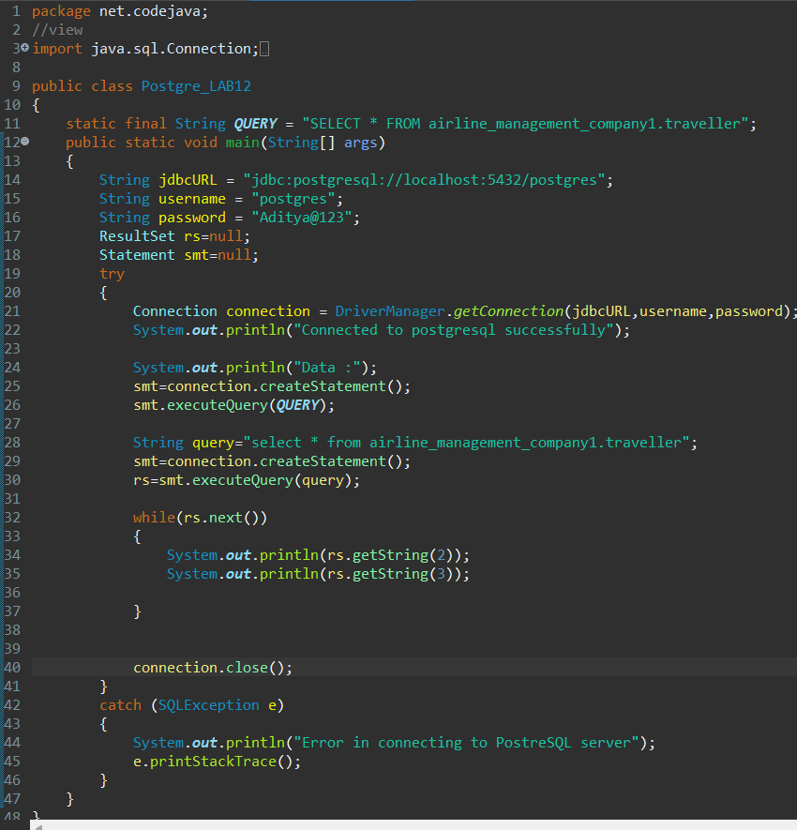
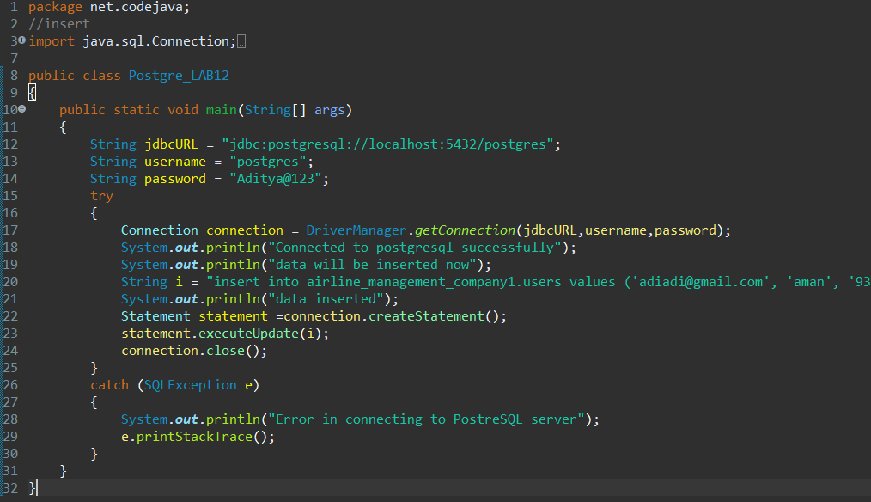
Java Code
View
Insert

Slide 19
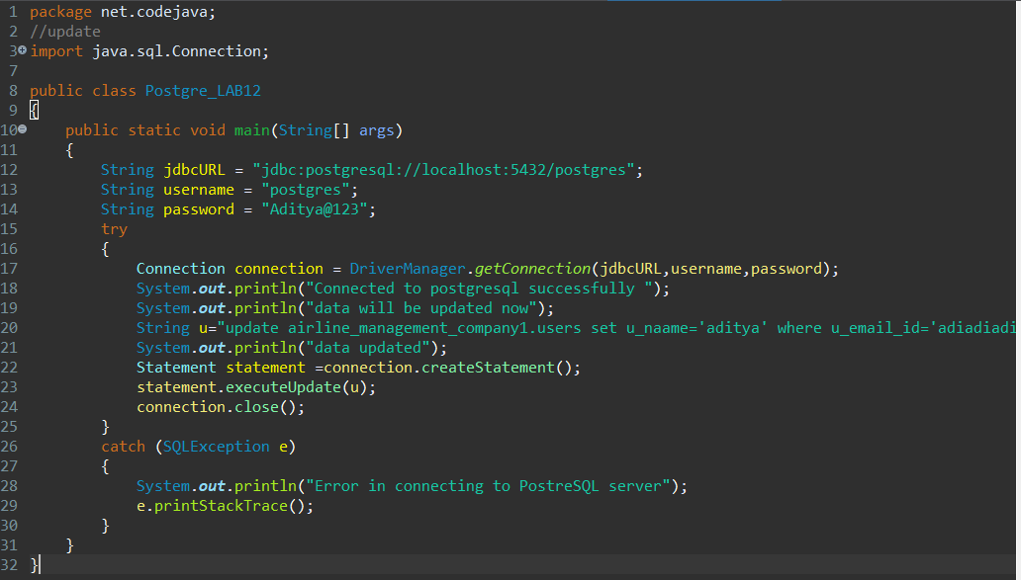
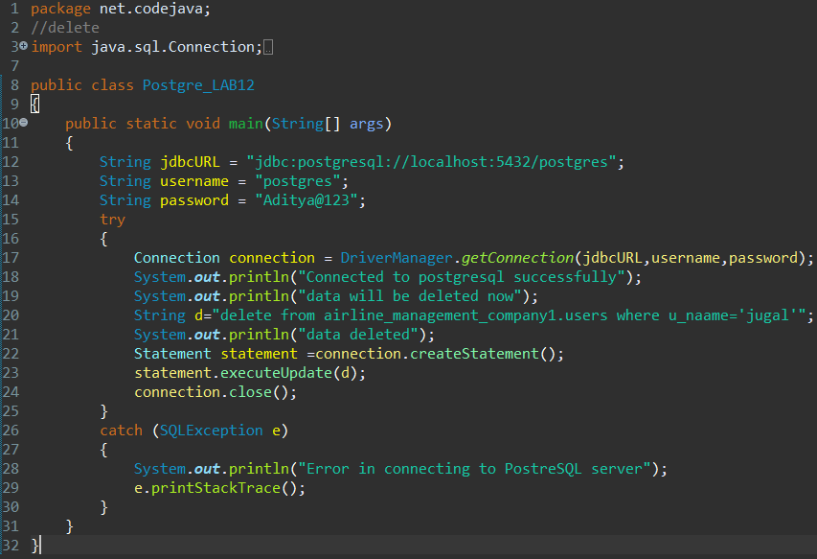
Java Code
Update
Delete

Slide 20



THANKS

